Slide 1
Eclipse Dev Training
Part 1: Basics
Ben Xu
Mar 2011
Version 2.0

Slide 2
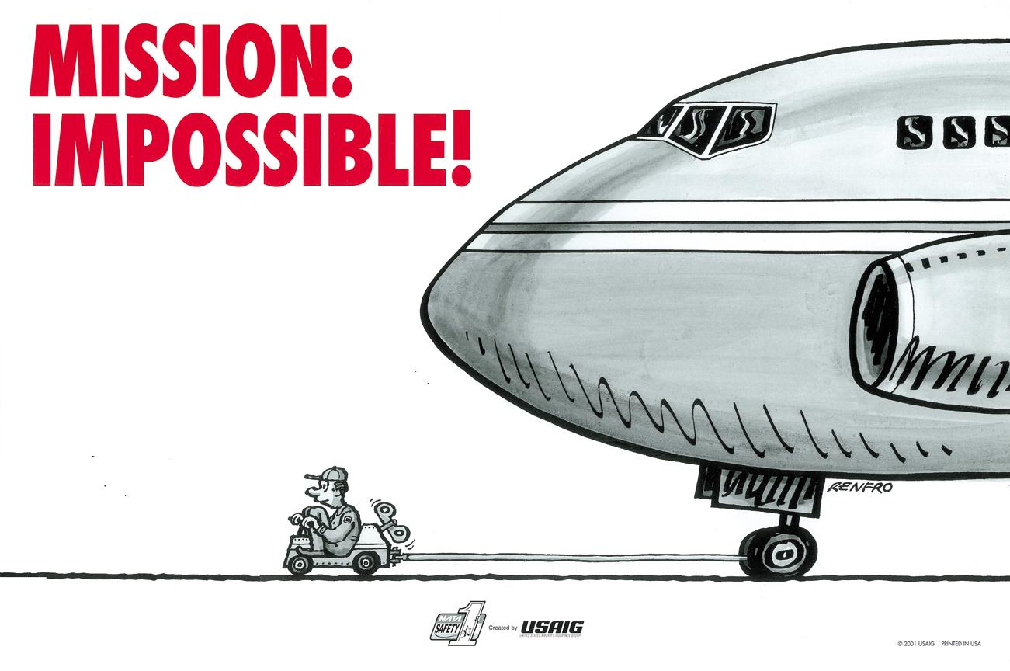
Objective
Master Eclipse Plug-in Dev in 1 Day is：
What you can learn is HOW TO DO IT in long term!

Slide 3
Objective
  Basic knowledge needed for eclipse development
    Eclipse introduction
    SWT/JFace for eclipse
    The eclipse plug-in framework & workbench component
  Eclipse plug-in development environment
    How to find &analyze existing code using T4Eclipse
    Eclipse source codes
  Effective and Systematic guidance for self-learning
    www.eclipse.org
    Eclipse community
    Related Eclipse books
    Related Eclipse training material

Slide 4
Arrangement
    9:30–9:45 Introduction
    9:45–10:30 Eclipse Basics
    10:30-10:40 Break
    10:40-11:30 SWT Basics & PDE environment
    13:30-14:40 SWT/JFace continued
    Task 1 & Break
    14:40-16:00 Analyze eclipse code
    Task 2 & Break
    16:00-17:00 Eclipse community and useful tools

Slide 5
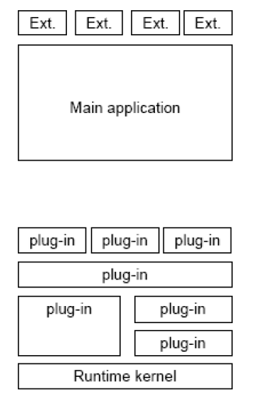
Eclipse Introduction
Common extensible application (like MS office, AutoCAD)
    Add-on concept
Eclipse
    True extensible architecture
    The Runtime Kernel is also build in plug-ins

Slide 6
Brief History of Eclipse
1999
April - Work begins on Eclipse inside OTI/IBM
2000
June - Eclipse Tech Preview ships
2001
March - http://www.eclipsecorner.org/ opens
June - Eclipse 0.9 ships
October - Eclipse 1.0 ships
November - IBM donates Eclipse source base
- eclipse.org board announced
- http://www.eclipse.org/ opens
2002
June - Eclipse 2.0 ships
September - Eclipse 2.0.1 ships
November - Eclipse 2.0.2 ships
2003
March - Eclipse 2.1 ships

Slide 7
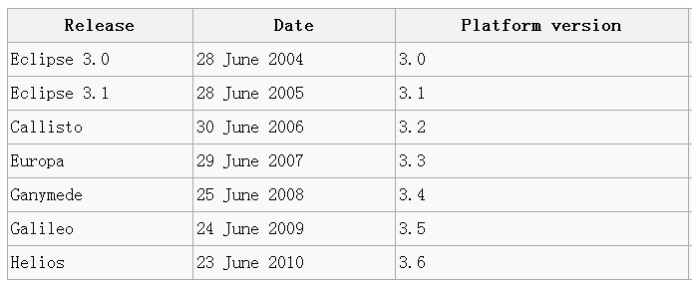
Brief History of Eclipse
Eclipse 3.7 is on the way!
E4 the next generation of eclipse!
Smartest version Vs Eclipse Version?

Slide 8
Eclipse Overview
Eclipse Platform
Another
Tool
Java
Development
Tools
(JDT)
Workbench
Help
JFace
SWT
Team
Your
Tool
Plug-in
Development
Environment
(PDE)
Workspace
Debug
Platform Runtime
Their
Tool
Eclipse Project

Slide 9
The PDE Environment
Plug-in development
environment
PDE
Java development
tools
JDT
Eclipse Platform
Platform
Standard Java2
Virtual Machine
Java VM

Slide 10
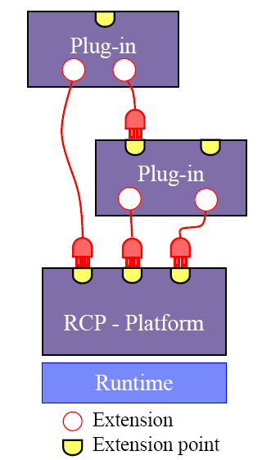
Eclipse Introduction
Plug-in - smallest unit of Eclipse function
  Everything is plug-in
  Declare its pre-requisites
Extension point - named entity for collecting “contributions”
  Example: extension point for workbench menu
Extension - a contribution
  Example: a menu item

Slide 11
Eclipse Introduction
Each plug-in
    Contributes to 1 or more extension points
    Optionally declares new extension points
    Depends on a set of other plug-ins
    Contains Java code libraries and other files
    May export Java-based APIs for downstream plug-ins
    Lives in its own plug-in subdirectory
Details spelled out in the plug-in manifest
    Manifest declares contributions
    Code implements contributions and provides API
    plugin.xml file in root of plug-in subdirectory
    Manifest file

Slide 12
Eclipse Introduction
Typical arrangement:
plug-in A
plug-in B
extension
point P
contributes
extension
interface I
implements
class C
creates, calls
Plug-in A
  Declares extension point P
  Declares interface I to go with P
Plug-in B
  Implements interface I with its own class C
  Contributes class C to extension point P
Plug-in A instantiates C and calls its methods

Slide 13
Eclipse Platform Architecture
Eclipse Platform Runtime is micro-kernel
    All functionality supplied by plug-ins
Eclipse Platform Runtime handles start up
    Discovers plug-ins installed on disk
    Matches up extensions with extension points
    Builds global plug-in registry
    Caches registry on disk for next time

Slide 14
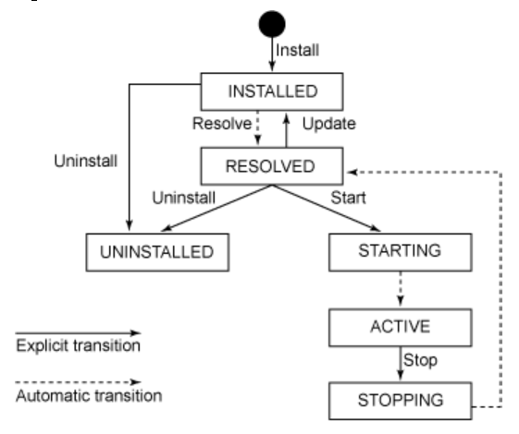
Eclipse Plug-in State
Notes:
http://www.ibm.com/developerworks/library/os-eclipse-bundlemgmt/index.html
http://help.eclipse.org/help33/index.jsp?topic=/org.eclipse.platform.doc.isv/guide/runtime_model_bundles.htm

Slide 15
Plug-in Activation
Each plug-in gets its own Java class loader
    Delegates to required plug-ins
    Restricts class visibility to exported APIs
Contributions processed without plug-in activation
    Example: Menu constructed from manifest info for contributed items
Plug-ins are activated only as needed
    Example: Plug-in activated only when user selects its menu item
    Scalable for large base of installed plug-ins
    Helps avoid long start up times

Slide 16
Demo & Exercise:
Create the first plug-in example project
Understand important plug-in files

Slide 17
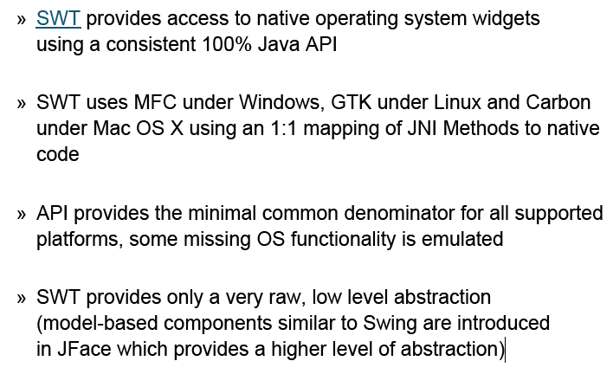
SWT Introduction
Notes:
SWT:Standard Windows Toolkit
AWT: Abstract Window Toolkit
http://www.eclipse.org/swt/
http://en.wikipedia.org/wiki/Standard_Widget_Toolkit
http://www.developer.com/java/other/article.php/3330861/SWT-Programming-with-Eclipse.htm

Slide 18
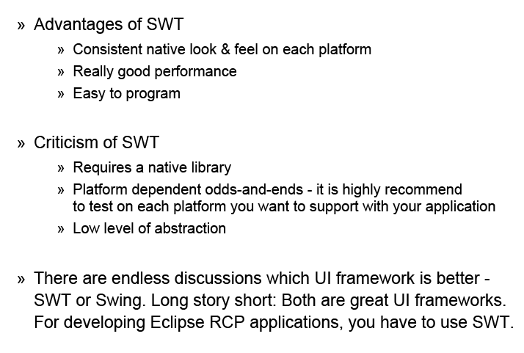
SWT (pros and cons)

Slide 19
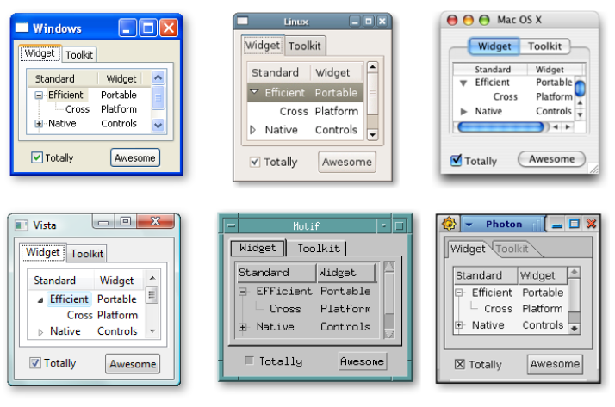
SWT on different platform

Slide 20
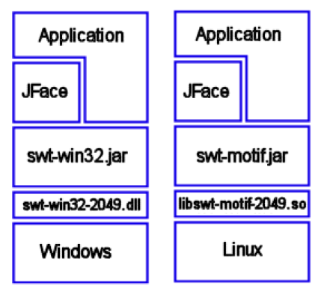
SWT on different platform
The Platform independent
SWT program
Same interface shared
for programming

Slide 21
SWT Widget
Displays are responsible from managing event loops and controlling communication between the UI thread and other threads.
A widget is a graphical user interface element responsible for interacting with the user.
A control is a user interface element that is contained somewhere within a top-level window, called a Shell.
Controls are common in all user interfaces. Buttons, labels, progress bars, and tables are all controls

Slide 22
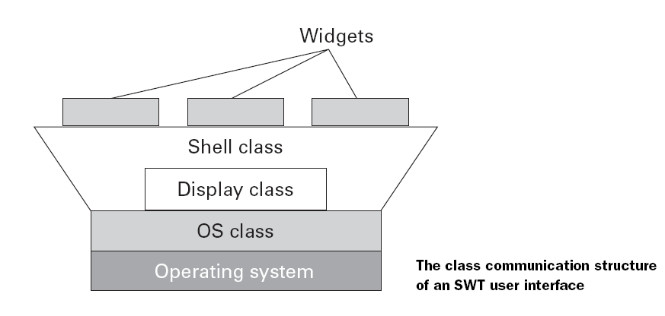
SWT Communication Structure

Slide 23
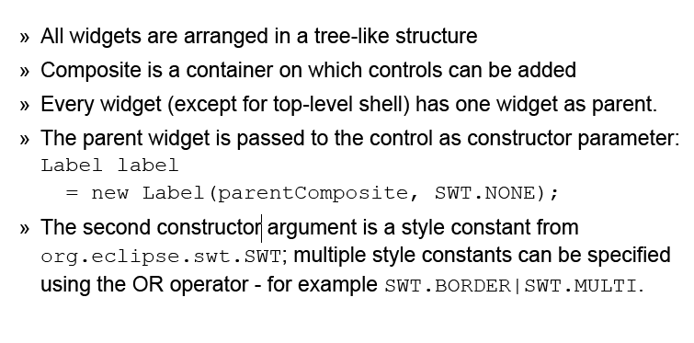
SWT Widgets

Slide 24
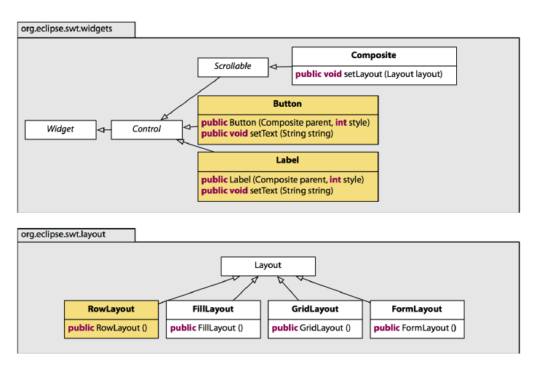
SWT Widgets API example

Slide 25
SWT Application
Creating a typical SWT application requires the following steps:
    Create a Display
    Create one or more Shells
      Set a Layout manager of the Shell
    Create widgets inside the Shells
    Open the Shell window
    Write an event dispatching loop
    Dispose display

Slide 26
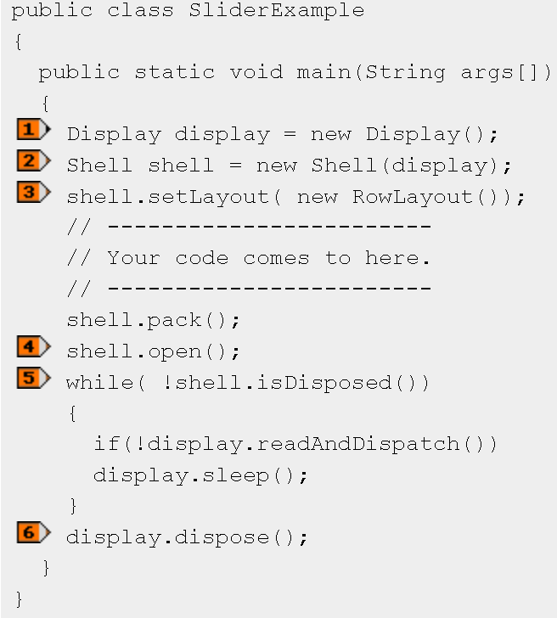
A Simple SWT Example

Slide 27
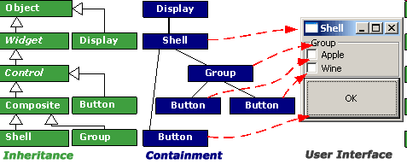
Building Block of SWT

Slide 28
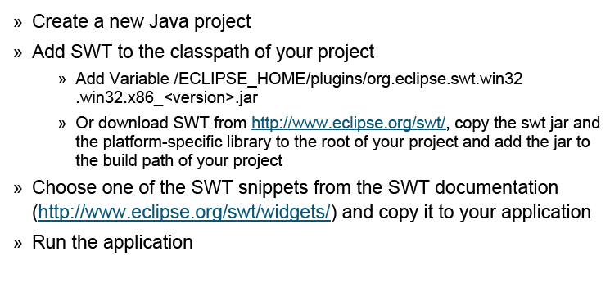
Using Standalone SWT

Slide 29
SWT Widgets & Code Snippets
Demo & Exercise:
First SWT Stand-Alone application
    set java project environment
      With source code
    Check widget class and it’s subclasses
    Check Display class

Slide 30
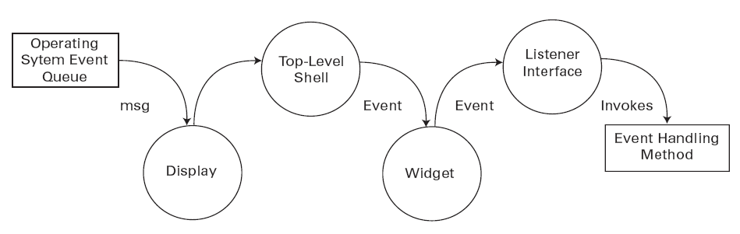
SWT Events
SWT Event Process Cycle
Notes:
Display provides an addFilter which can block the event

Slide 31
SWT Events
  An event is simply an indication that something interesting has happened.
      Events, such as "mouse down" and "key press," are issued when the user interacts with a widget through the mouse or keyboard.
      Event classes, used to represent the event, contain detailed information about what has happened.
  Listener methods always take an instance of an event class as an argument. When something interesting occurs in a widget, the listener method is invoked with an appropriate event.

Slide 32
SWT Untyped Events & Listener
  Untyped listeners provide a simple, generic, low-level mechanism to handle any type of event
  widget.addListener(SWT.Dispose, new Listener() {
  public void handleEvent(Event event) {
  }
  });
  removeListener(int type, Listener listener)
  Removes the listener from the collection of listeners that will be notified when an event of the given type occurs.
Notes:
Why Are There Two Listener Mechanisms?
In early versions of SWT, there were only untyped listeners. After considerable discussion between the Eclipse implementers, the SWT user community, and the developers, it was decided to include a more "JavaBeans-like" listener mechanism. .
We recommend that SWT applications always be implemented in

Slide 33
SWT Untyped Events & Listener
  SWT.KeyDown A key was pressed
  SWT.KeyUp A key was released
  SWT.MouseDown A mouse button was pressed
  SWT.MouseUp A mouse button was released
  SWT.MouseMove The mouse was moved
  SWT.MouseEnter The mouse entered the client area of the control
  SWT.MouseHover The mouse lingered over a control
  SWT.MouseExit The mouse exited the client area of the controlSWT.
  MouseDoubleClickA mouse button was pressed twice
  …..

Slide 34
SWT Typed Events & Listener
  A typed listener follows the standard JavaBeans listener pattern. Typed listeners and their corresponding event classes are found in the package org.eclipse.swt.events.
  widget.addDisposeListener(new DisposeListener() {
  public void widgetDisposed(DisposeEvent event) {
  }
  });

Slide 35
Demo & Exercise:
SWT Typed and Untyped Listeners Demo
The Address Book SWT complete Exampl

Slide 36
SWT Layout
By default SWT does not set size or position of it’s components.
Every new control has the size (0,0), so it is invisible.
Applications can define positions and sizes of controls
when they are created or later (inside resize listener):
    » Control.setSize(Point point)
    » Control.setSize(int x, int y)
    » Control.setBounds(Rectangle rect)
    » setBounds(int x, int y, int width, int height)
Alternatively, a Layout may be specified. An instance of the
Layout class will be responsible for sizing and positioning controls.

Slide 37
SWT Layout
A layout controls the position and size of child elements
in a Composite
    » Composite.setLayout(Layout layout)
The size and positioning of a control can be defined by setting anobject with layout data
    » Control.setLayoutData(Object layoutData)
SWT layouts are similar to layouts in AWT / Swing
It is possible to define custom layouts:
Layout classes are subclasses of the abstract class Layout.

Slide 38
Demo & Exercise:
SWT Layout

Slide 39
SWT Thread
    SWT Thread also eclipse thread
      Display.syncExec Display.asyncExec
    There is ONLY ONE UI thread.
      Use the above Display method when you need to use the UI functionalities in other thread

Slide 40
SWT Dialogs
Dialog is not Widget
SWT Dialog Represent built in platform dialogs
There is a number of SWT dialogs
(org.eclipse.swt.widgets.Dialog)
    » ColorDialog - prompts to select a color
    » DirectoryDialog - prompts to select a directory
    » FileDialog - prompts to select a file
    » FontDialog - prompts to select a font
    » PrintDialog - prompts to select a printer to start a print job
    » MessageBox - displays a message to the user

Slide 41
JFace Dialogs
Dialog is not Widget
SWT Dialog Represent built in platform dialogs
There is a number of SWT dialogs
(org.eclipse.swt.widgets.Dialog)
    » ColorDialog - prompts to select a color
    » DirectoryDialog - prompts to select a directory
    » FileDialog - prompts to select a file
    » FontDialog - prompts to select a font
    » PrintDialog - prompts to select a printer to start a print job
    » MessageBox - displays a message to the user

Slide 42
JFace Views
Eclipse JFace viewers allow to display a domain model in a list, tree or table without converting the domain model beforehand.
These viewers provider adaptors which are used to provide the model to the viewer (these are called content provider) and adaptors to define how the model data is displayed in the viewer (these are called label providers).
The Eclipse JFace viewer concept is very flexible as it allows to use the same content provider / label provider in different viewers without changing the underlying data structure.

Slide 43
Demo & Exercise:
JFace Diaog, JFace View Example

Slide 44
Eclipse Workbench
» ... is the UI metaphor used by Eclipse;
» ... contains zero to many workbench windows;
» ... normally opens a window on a start;
» ... automatically gets closed when the last window
is closed (default behavior).

Slide 45
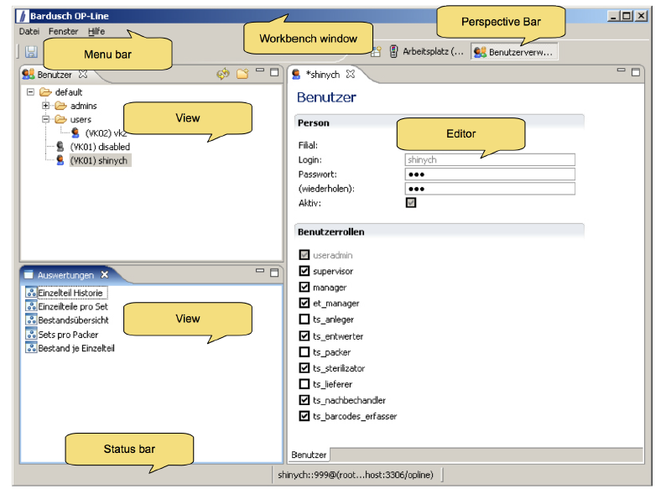
Eclipse Workbench

Slide 46
Eclipse Workbench
Workbench (1)
  » Windows (0-N)
    » Page (0-1)
      » Perspectives(0-N)
      » Views (0-N)
      » Editors (0-N)

Slide 47
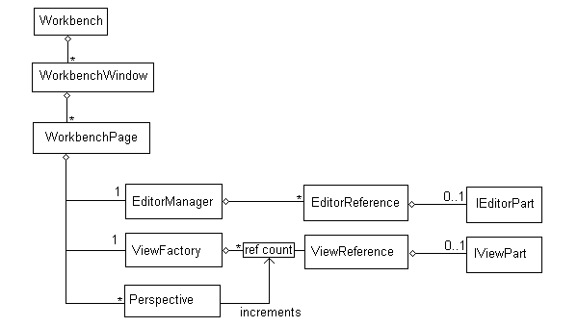
Eclipse Workbench
Both IEditorPart and IViewPart implements IWorkbenchPart
Both IEditorReference and IViewReference implements IWorkbenchPartReference

Slide 48
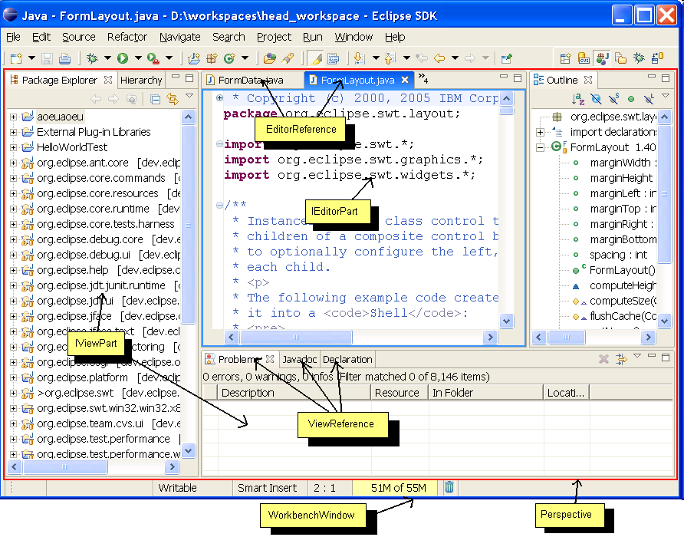
Eclipse Workbench
Notes:
http://www.eclipse.org/articles/Article-UI-Workbench/workbench.html

Slide 49
Workbench API
» An instance of IWorkbench is the entry point for most APIs
» There is only one instance of this interface within each application (Singleton):
IWorkbench workbench = PlatformUI.getWorkbench();

Slide 50
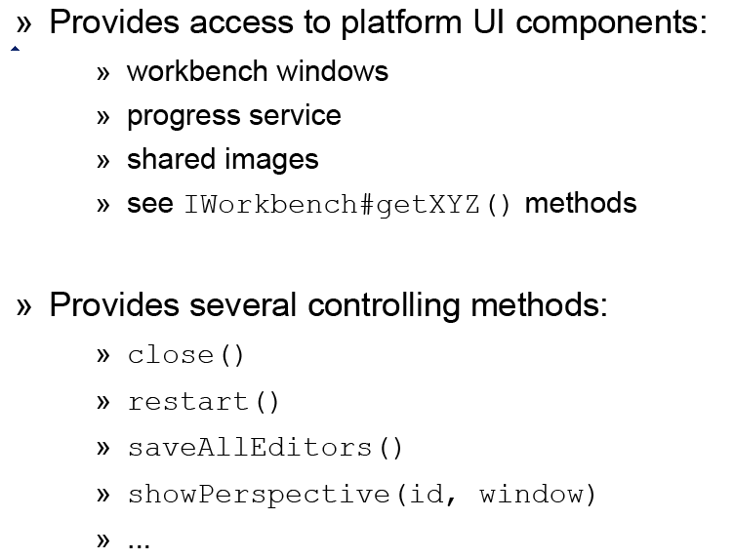
Workbench API

Slide 51
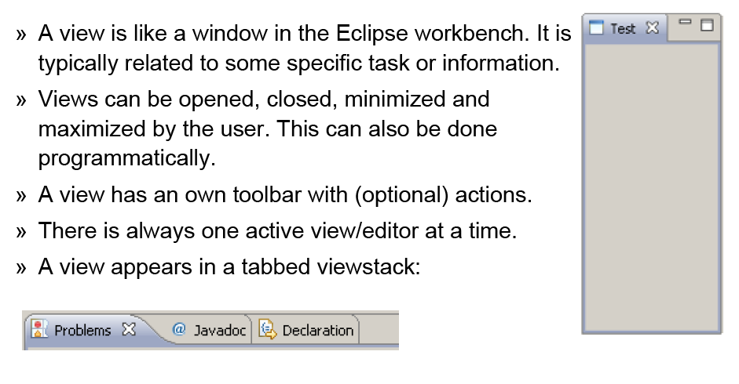
Eclipse View

Slide 52
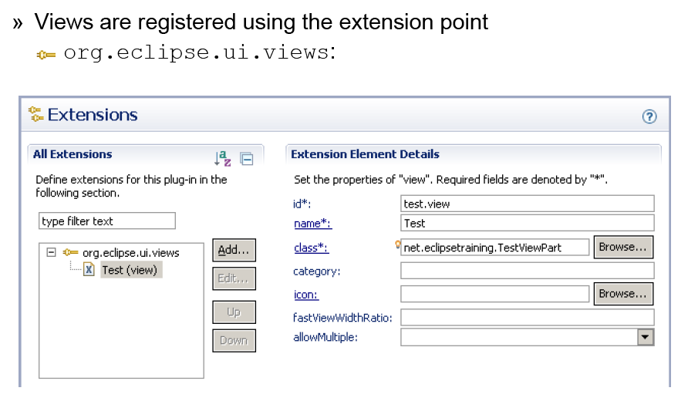
Eclipse View

Slide 53
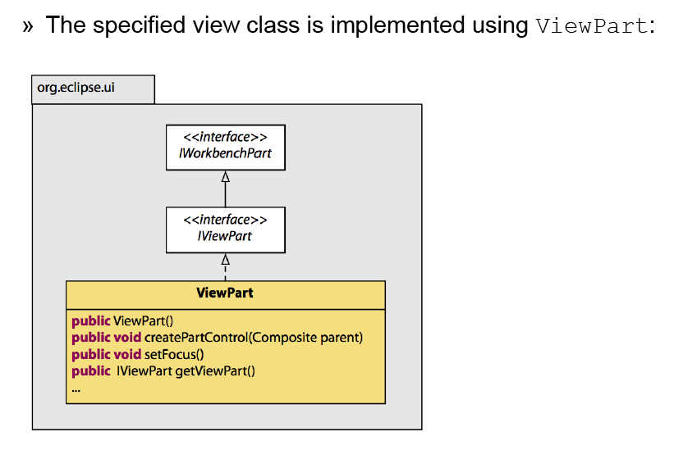
Eclipse View

Slide 54
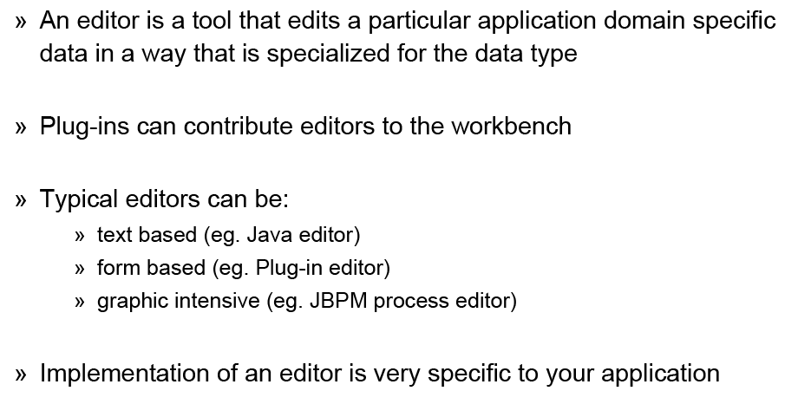
Editor

Slide 55
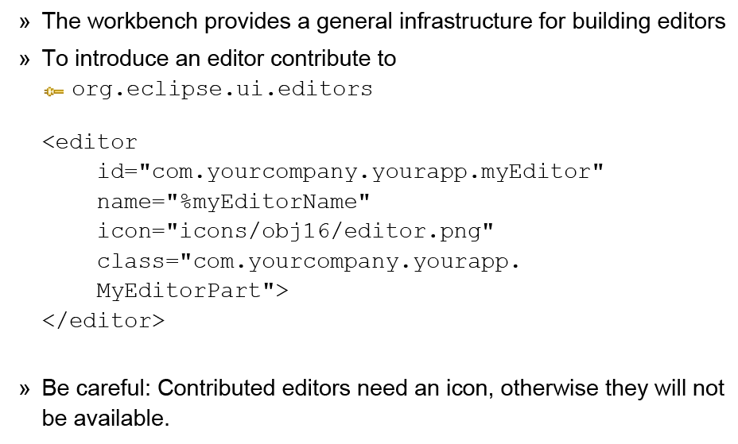
Editor

Slide 56
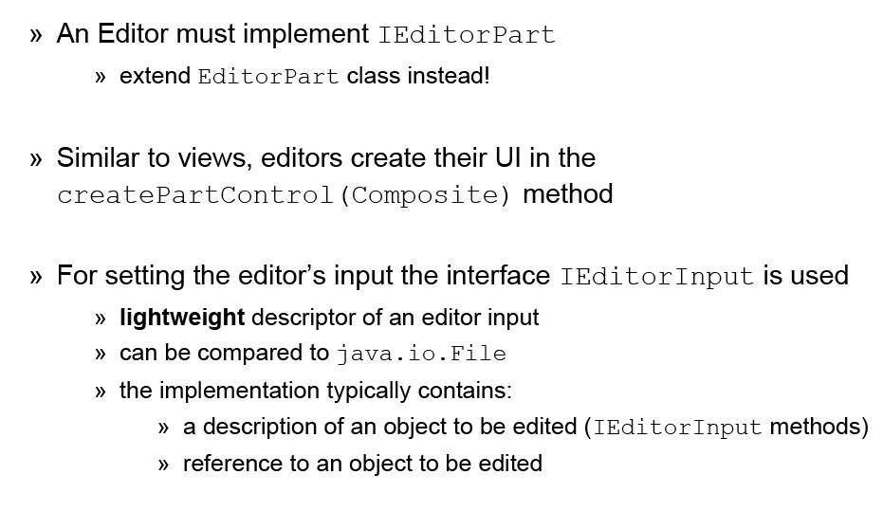
Editor

Slide 57
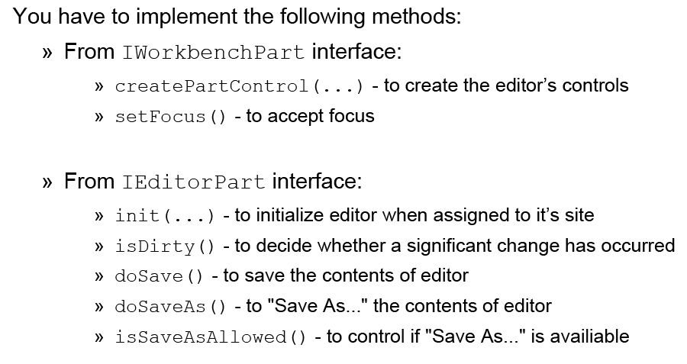
Editor

Slide 58
Demo & Exercise:
an Eclipse View Example
IEditorPart related Class
Write an Eclipse Action (depend on time)

Slide 59
A Systematic Approach to Learn Eclipse
STEP1: Use Eclipse as a Java Develop environment
    Finish the following four eclipse training
        Using the Eclipse Workbench
        Eclipse and Java for Total Beginners
        Eclipse and Java: Introducing Persistence
        Eclipse and Java: Using the Debugger (Very Good One)
        http://eclipsetutorial.sourceforge.net/
    Use Eclipse by reading Eclipse helps
        Workbench User Guide
        Java Development User Guide

Slide 60
A Systematic Approach to Learn Eclipse
STEP2: SWT/JFace & PDE environment
    SWT is the base and worth learn systematically
      Book <<SWT.The.Standard.Widget.Toolkit.Volume.1>>
      SWT Code snippets and Examples
    Use JFace when needed
      Know existing JFace features
      Learn by use
    Learn PDE environment
      Develop basic eclipse plug-ins with example
      Reference eclipse Help
        Platform Plug-in Developer Guide
        Plug-in Development Environment Guide

Slide 61
A Systematic Approach to Learn Eclipse
STEP3: Master Eclipse Plug-in Development
    Eclipse Building Commercial-Quality Plug-ins
      http://www.qualityeclipse.com/
    In depth eclipse mechanisms and common services
      Related eclipse articles
        Selection Service, Adapter, Wizard, Preferences, Undo-redo, Copy-Paste…
        Each one own one part and present to others?
    Engage with the eclipse community
      Newsgroups
      Report and fix bugs for eclipse
      Contribute to Eclipse community

Slide 62
Recommend Books
SWT: The Standard Widget Toolkit, Volume 1 (Steve Northover)
    In-depth SWT written by SWT commiter
    http://www.informit.com/store/product.aspx?isbn=0321256638
Building Commercial Quality Plug-ins (Clayberg, Rubel)
    http://www.qualityeclipse.com/
Official Eclipse 3.0 FAQs (Arthorne, Laffra)
    http://wiki.eclipse.org/index.php/Eclipse_FAQs

Slide 63
Recommend Eclipse Sites
www.eclipse.org
http://www.eclipse.org/resources/
http://www.eclipse.org/forums/
http://wiki.eclipse.org/
http://live.eclipse.org/
http://marketplace.eclipse.org/
http://www.eclipsecon.org/
http://planeteclipse.org/
http://eclipse.dzone.com/
http://www.ibm.com/developerworks/

Slide 64
Recommend Eclipse Articles
Eclipse Platform Overview:
http://www.eclipse.org/articles/Whitepaper-Platform-3.1/eclipse-platform-whitepaper.pdf
PDE Environment Introduction:
http://www.eclipse.org/articles/Article-PDE-does-plugins/PDE-intro.html
Layout:
http://www.eclipse.org/articles/article.php?file=Article-Understanding-Layouts/index.html
Eclipse Adapters:
http://www.eclipse.org/articles/article.php?file=Article-Adapters/index.html
Eclipse Actions:
http://www.eclipse.org/articles/article.php?file=Article-action-contribution/index.html

Slide 65
Recommend Eclipse Articles
Eclipse Selection Service:
http://www.eclipse.org/articles/Article-WorkbenchSelections/article.html
Eclipse Preference:
http://www.eclipse.org/articles/Article-Preferences/preferences.htm
Eclipse Wizards:
http://www.eclipse.org/articles/article.php?file=Article-JFaceWizards/index.html
Eclipse Workbench:
http://www.eclipse.org/articles/Article-UI-Workbench/workbench.html

Slide 66
SWT/JFace & Code Snippets
SWT Widgets:
    http://www.eclipse.org/swt/widgets/
  SWT Code Snippets:
  http://www.eclipse.org/swt/snippets/
  SWT Examples:
  http://www.eclipse.org/swt/examples.php
  JFace Code Snippets
http://wiki.eclipse.org/index.php/JFaceSnippets

Slide 67
www.eclipse.org
Eclipse Projects
Eclipse Articles
Eclipse CVS
Eclipse Newsgroup
Eclipse Helps
http://www.eclipse.org/documentation/
    For 3.5 http://help.eclipse.org/galileo/index.jsp
Eclipse Bugzilla
Eclipse Market Place

